Slide 1
WCCUSD Early Learning Program Overview By Olanrewaju Ajayi, Coordinator

Slide 2
WCCUSD California State School Preschool Program
Goal: To ensure that all our students are safe and have fun while learning
Rationale:
Early education programs are seen as important mechanism for helping children develop the skills they need for school readiness.
Partners:
Parents – Key to the program success is parent participation. This provides families with skills and strategies for home/ school connection and readiness.

Slide 3
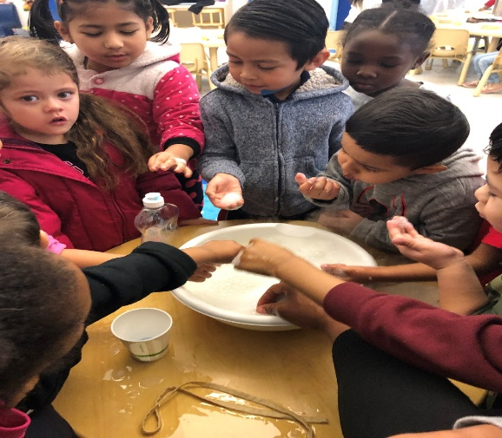
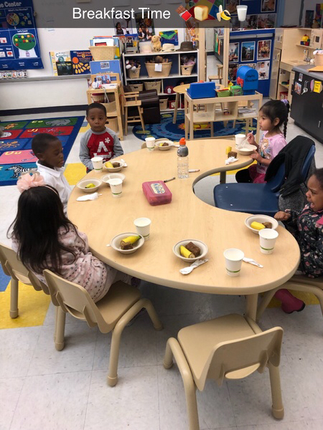
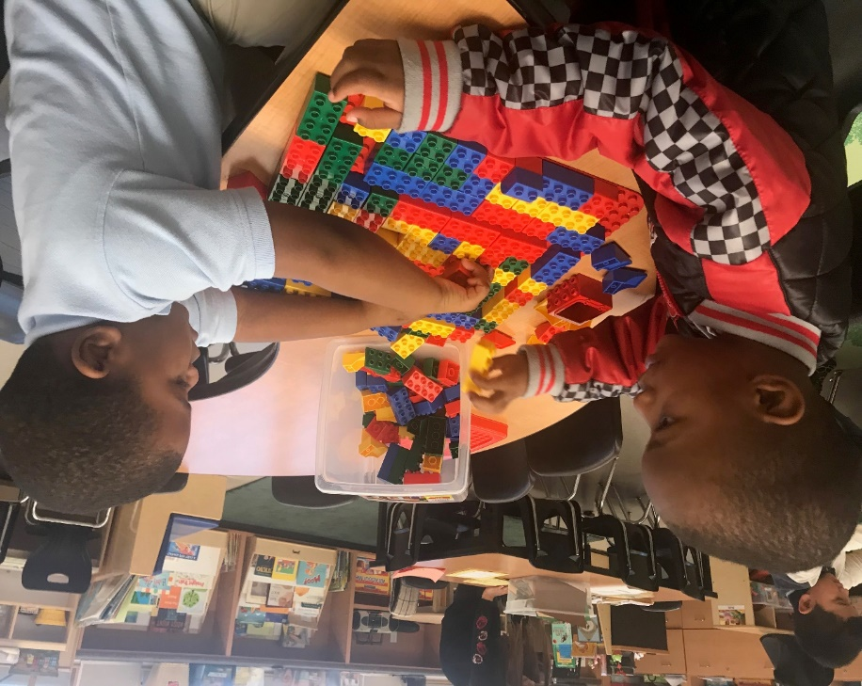
Lunch Eligibility
77 % of CSPP students are on free and reduced lunch

Slide 4
SUCCESSES
WCCUSD CSPP currently provides 11 Part Day to eligible children of low income communities. The families at our sites have low income or are on government assistance. The families especially in Richmond Iron Triangle where some of our Programs are located, face multiple pressures of poverty, immigration related issues, high crime environment, low family educational attainment and sometimes drug use that impacts their ability to adequately support their children’s learning. Our program provides a critical haven for young children to acquire the necessary foundational skills that enables school success.

Slide 5
Successes contd.
High Quality Preschool Program- QRIS ( Quality rating information system) Seven Tier 5 sites & Eight Tier 4 sites.
All CSPP teachers are full credentialed and have ECE permits.
Online Professional Development and Refresher courses provided for teachers and instructional Assistants in the following areas- small group and large group instructions; intervention and differentiation of instruction and developmentally appropriate instruction.
Planning time for staff during and after school.
Academic Conferencing –Analysis of Data and sharing strategies.
Learning Genie App for efficient Data collection for DRDP assessment and family communication.
Development of SMART goals (Specific Measurable Achievable Realistic and Timed) in the area of student achievement.
Enrollment practices- advertising in Local magazines, Bus tails, Local Movie theaters, Faith based agencies, Laundromats and Stores.
Professional Learning communities to assist peer collaboration.
99% of students in WCCUSD preschools met early literacy benchmarks in spring 2017 (GO Public Schools West Contra Costa –pg.26).
Excellent Family Involvement, Communications & Trainings( Ready4k –text messages to enhance Literacy skills at home; Newsletters and children’s magazines.

Slide 6
CHALLENGES
Some of the challenges faced by school Districts in implementing Full Day/ Extended Year Preschool Programs are as follows:
Scheduling the required program days from 180 days to 246 days.
Lack of staff due to Covid -19.
Lack of on-site administrative support at the sites during summer months due to administrative work year schedule and vacations.

Slide 7
CHALLENGES
Coordinating work calendar with site administrators to provide administrative coverage for full day programs, not all school sites are used for summer school.
Collaborating with Human Resources and Teachers Union to extend teachers work calendar and arrange for subs to cover classes during summer months.
Ensuring that enrollment is advertised continuously.
Students’ attendance during summer months when older siblings are on vacation.

Slide 8
Partners
Tandem
Literacy workshops and training for parents and staff.
Interactive read aloud twice weekly to students.
Give away books to children & families.
Child Care Solutions – Upon referral and with parent permission
Free On- site consultation with staff
Provide support for staff
In-service training
Initial Observation and assessment of a child
Referral to community resources
Contra Costa County Of Education & First 5
Support with QRIS ( Quality Rating Improvement Scale) implementation

Slide 9
The focus is on giving children access to rich integrated education
Our teachers are fully credentialed and the aides are highly trained
Designed for 3, 4 & 5 year olds
Classroom environment are developmentally appropriate, safe and nurturing
Students develop problem solving, critical thinking skills, foundational skills that promote lifelong learning
11 classrooms at the following sites - Bayview; Chavez; Dover; Downer; Ford;
King; Lincoln;Montalvin; Murphy; Riverside; Washington

Slide 10
Early Learning Program Theory of Action
Our Theory of Action for the program guides our continuing efforts to ensure that all our programs are high quality , with the final belief and expectation that ALL students will have access to high levels of educational success in social, emotional, behavior as well as academic readiness skills.
If we develop a culture where every adult in the program and the greater community act upon the belief that ALL students are capable of learning at higher levels, then ALL our students will be exposed to greater opportunities and support necessary for school success.
If we ensure by providing needed Professional Development opportunities that supports rigorous, research based curricula, taught to meet student individual needs for program staff, then we will be able to provide ALL students with accelerated learning and close the identified achievement gaps.
If we engage in a deep and continuous process of data-driven decision-making with the best interests of our students in mind, then we will expand successful programs and support our areas in need.

Slide 11
Hours of Operation & Strategy
Monday – Friday
Part Day Class
8:15 - 11:15 AM - Class
12:00 - 3:00 PM – Class
Strategy:
A Preschool Center based Learning Program for Children-
Literacy Center- Children participate in Literacy related activities - Read aloud, Alphabet & sound recognition; sight words & rhyming.
Children’s stories is creatively woven into the daily activities of Oral Language Development skills which is strengthened through small group activities.

Slide 12
STRATEGY
The introduction of concepts is based on interactive hands-on activities.
Daily Social Skills training to address social – emotional development.
Use of technology and manipulatives at the various Learning Centers-Language Arts; Music; Math; Science & Arts.
Educational Games and interactive hands- on activities provide greater understanding of concepts and enrichment.

Slide 13
Curriculum for State Preschool
Core Curriculum
California Preschool Learning Foundations
My Math In Pre-K – McGraw Hill
Teacher Created Materials
Supplementary Curriculum
Environmental Rating Scale
Second Step – Social Skills Curriculum

Slide 14
Assessments for Preschool Program
DRDP ( Desired Results Developmental Profile)
Administered in Fall ( 1st 60 of enrollment days ) & in Spring
Student Portfolio
Teacher made test

Slide 15
The DRDP – R Assessment Cycle
Observe children and environment
Implement curriculum and environment
Complete assessments
Modify curriculum and environment
Summarize assessments
Complete Summary of Findings and analyze data

Slide 16
PROFESSIONAL DEVELOPMENT
Some of the professional development required for all Early Learning Staff-
Classroom Assessment Scoring System ( CLASS)
Teaching Pyramid ( promotes social emotional development)
Environmental Rating Scale (ECER’s)
Desired Results Developmental Profile (DRDP 2015)- based on observation and use of developmental Continuum from Early Infancy to Kindergarten level
California Preschool Learning Foundations
Learning Genie- APP for DRDP assessment

Slide 17
For more information contact our website
HTTP://WWW.WCCUSD.NET/DOMAIN/973
HTTP://WWW.EARLYLEARNINGDEPARTMENT.ORG

